Slide 1

No jQuery No Visual Studio
JavaScript framework for writing less Client Side Rendering code
For SharePoint Power Users
with basic understanding of
HTML, CSS & JavScript
iCSR.GitHub.io

Slide 2
In this slidedeck
Standard SharePoint Client Side Rendering (CSR)
Why SharePoint Client Side Rendering?
What is SharePoint Client Side Rendering
How to create CSR files with the Cisar (by Andrei Markeev) Chrome Extenstion
Managing JSLinks with the LinkManager Bookmarklet
Less CSR code with iCSR
Why iCSR was created
How to enhance a Document Library with iCSR Templates
How to configure iCSR Templates
Writing your own iCSR Templates

Slide 3
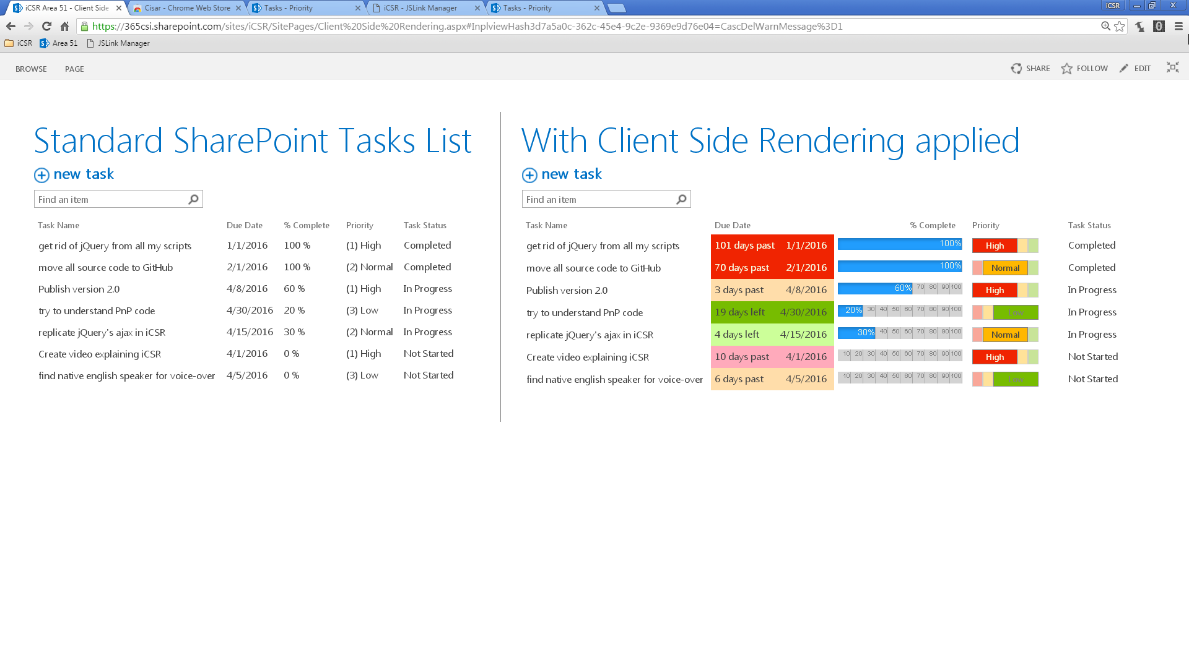
Before & After Client Side Rendering is applied

Slide 4
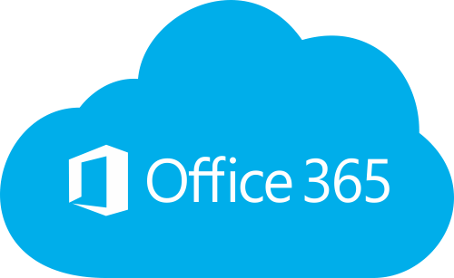

Client Side Rendering (CSR) transforms data before it is displayed in the Browser
CSR
HTML CSS JavaScript
Browser
Data
jQuery
jQuery solutions make changes AFTER the page has loaded
iCSR helps writing less CSR code

Slide 5
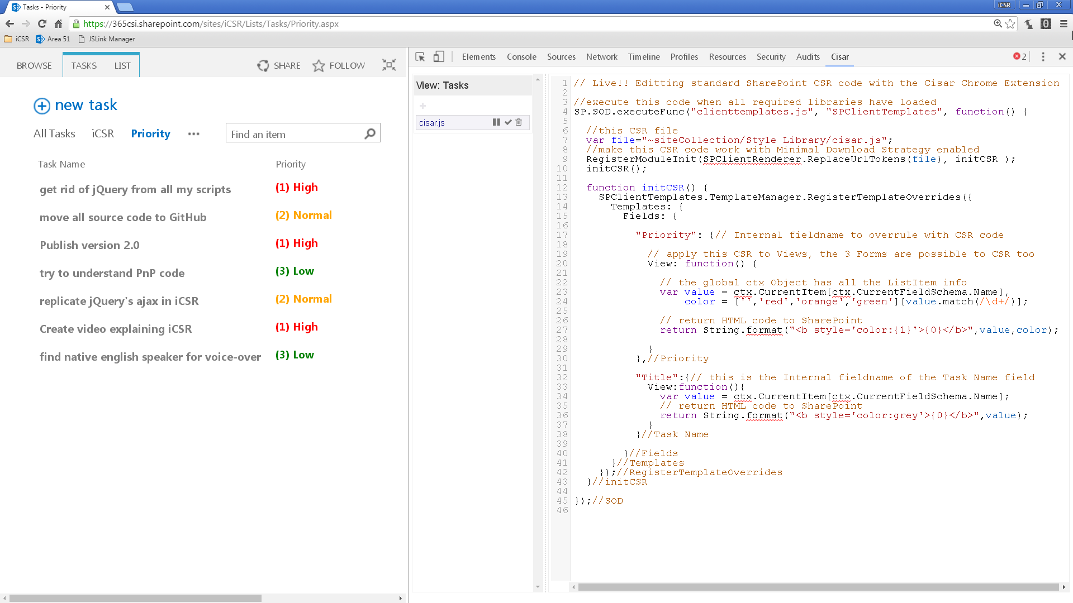
Creating NEW CSR files with the Cisar Chrome Browser Extension (by Andrei Markeev) With Live Editing!
The Cisar Chrome Browser Extension (by Andrei Markeev) is available in the Chrome App Store: https://365CSI.nl/cisar
2. Add a new file with the +
Cisar saves files to the Style Library, which has Versioning enabled, you need to publish (checkmark button) the file so everyone can view your CSR transformations.
Tip: When you are about the make many changes in the editor, use the Pause button to pause the Live Update (after Play you need to make an edit to thrigger your updates or press F5 to reload the page
WebPart
JSLink
CSR file
!! CSR can only be applied to fields available in the View !! So in this example the Task Name could only be formatted with Priority values. Tip: When you do need more (non displayed) fields; wrap them in a Calculated Column, and apply CSR code to rewrite the HTML

Slide 6
CSR files are stored in a Document Library
CSR (JavaScript) files are linked to displaying WebParts (Views or Forms) using JSLink
Cisar saves to ~sitecollection/Style Library by default
Other tokens ~site/mysites/mylibrary can be used in JSLinks
Multiple files are separated by | (pipe symbol)
Office365/SharePoint Online accepts absolute URLs
The WebPart Properties UI has a JSLink option (see next slide) with code, JSLinks can be set on Fields, ContentTypes, etc.

Slide 7
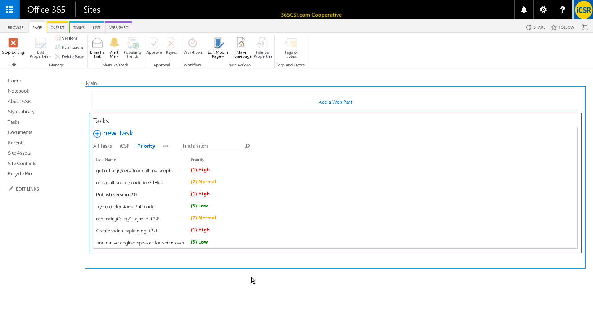
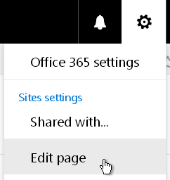
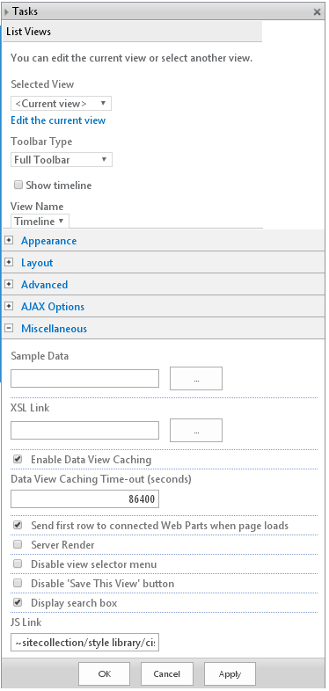
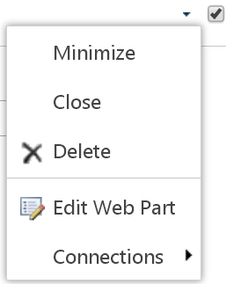
Setting the WebPart Properties JSLink connection to existing CSR files by hand in 9 clicks
1
9
2
Can you image the work when applying JSLinks connections to CSR files in multiple Lists and Libraries? So we quickly built an extra iCSR tool to automate this..
3
5
4
6
7
~sitecollection/…/csr_file1.js | ~sitecollection/…/csr_file2.js
8

Slide 8
JavaScript framework for writing less Client Side Rendering code
LinkManager BookMarklet for making less UI clicks
iCSR.GitHub.io

Slide 9
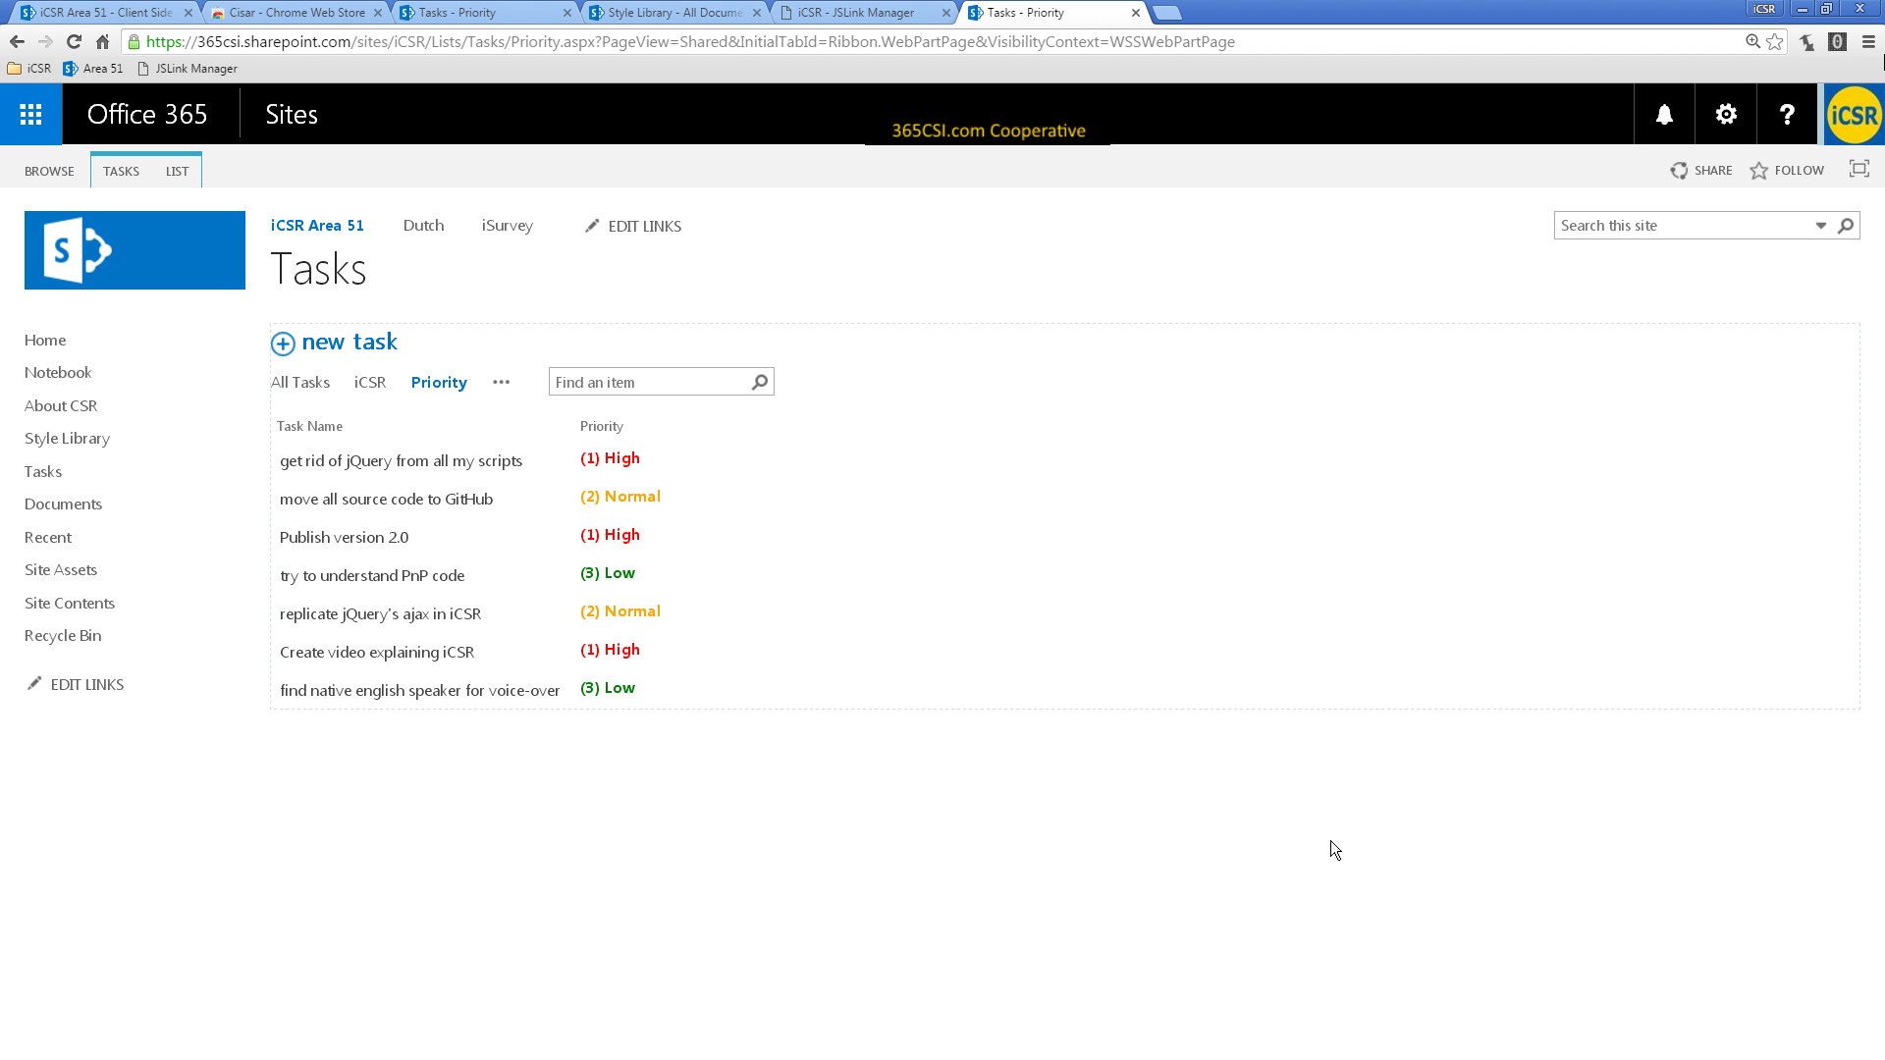
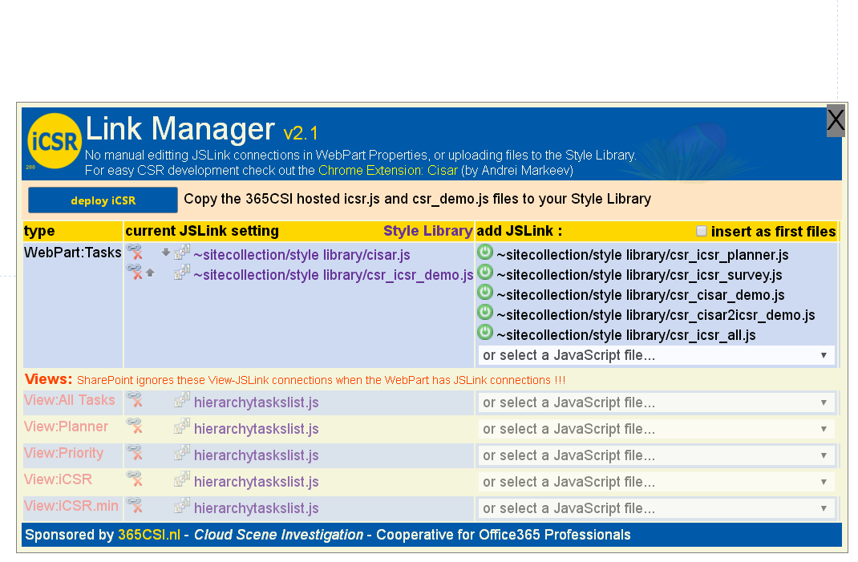
Setting JSLinks to existing CSR files with the free LinkManager BookMarklet … in 2 clicks
1
Install the LinkManager Bookmarklet (for all Browsers) at https://365CSI.nl/jsl
2
A BookMarklet (works in any Browser) executes JavaScript code with the current Users rights. If run by a Site Collection Administrator (write access to the Style Library) It can be more powerful compared to an App deploying code.
The iCSR LinkManager Bookmarklet can
Add files to the Style Library
Set JSLinks on WebParts and Views
The Free LinkManager itself is not added to your Office365 environment, the code is downloaded from our 365CSI server every time you click the LinkManager Favourite
Now you know the CSR concept and the tools to use… let’s introduce iCSR

Slide 10
No jQuery No Visual Studio
JavaScript framework for writing less Client Side Rendering code
iCSR.GitHub.io

Slide 11



Client Side Rendering can be as easy as IKEA
and as much fun as Lego add some simple JavaScript code
And you get iCSR

Slide 12
iCSR is not a power-do-it-all-framework, but can be used by all developers
Power users Basic understanding of HTML, CSS and JavaScript
jQuery lovers
Gurus
JavaScript framework for writing less Client Side Rendering code

Slide 13
Write less CSR code with iCSR
This is mainly the same boilerplate code for every CSR file

Slide 14
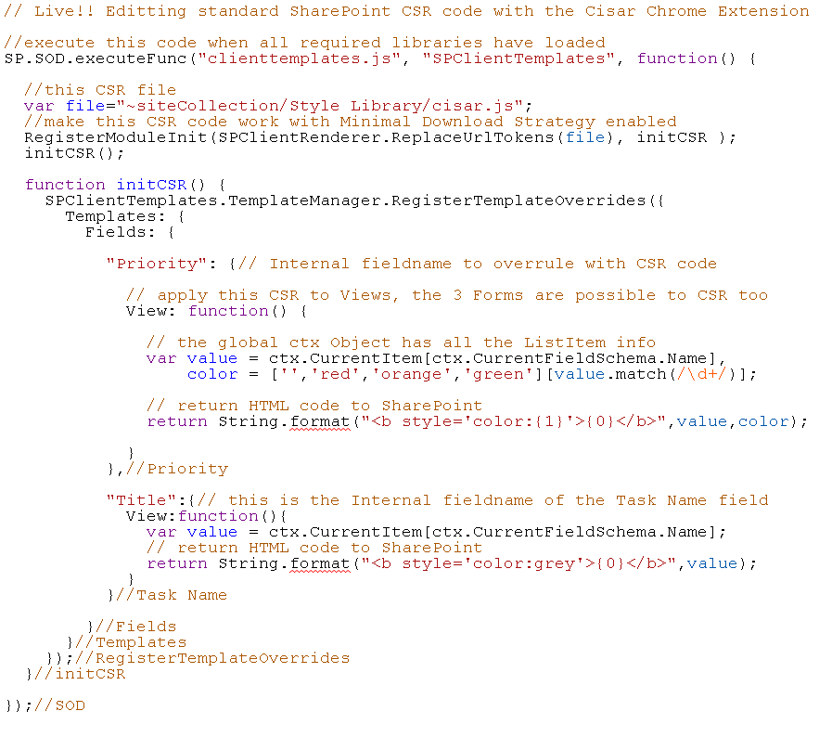
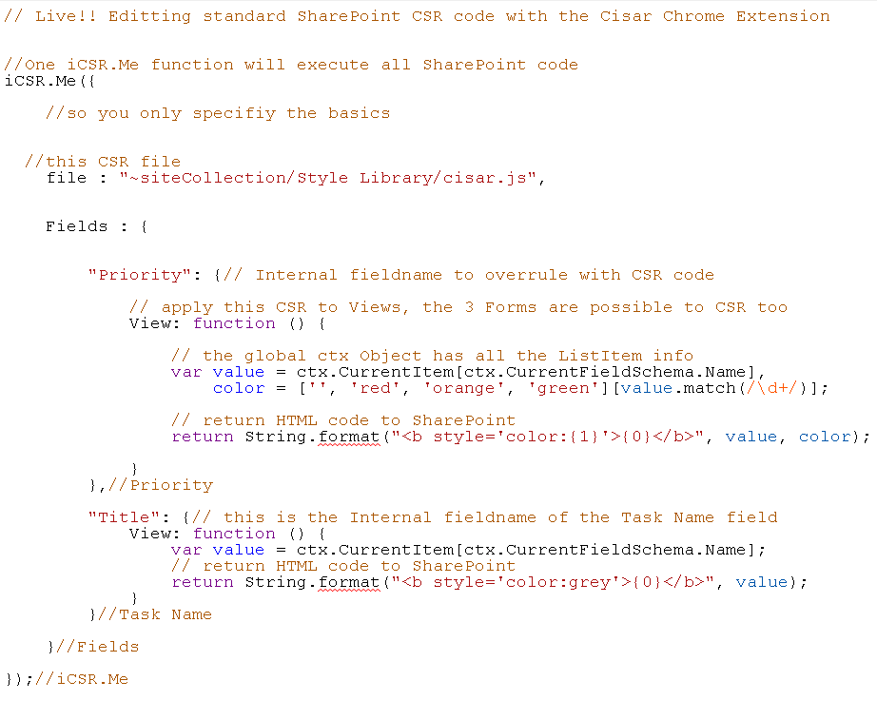
Write less CSR code with iCSR : Step #1 : get rid of boilerplate code
iCSR.Me() function takes care of all the boilerplate code You only have to supply the configuration

Slide 15
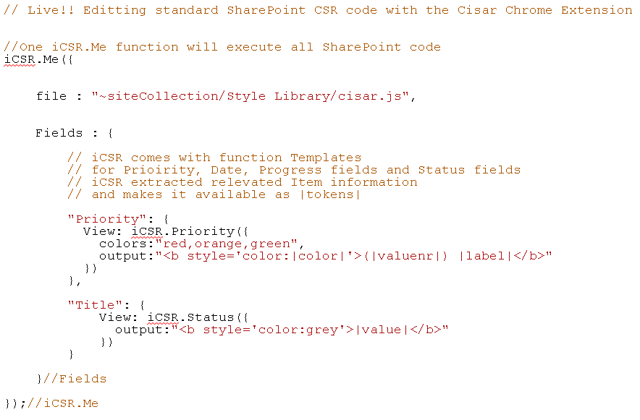
Step #2 : use (Item) pre-processed iCSR |token| values
iCSR.Templates functions (Priority, PercentComplete, DueDate) pre-process every ListItem so you can write even less CSR code using iCSR |token| notation to built an output (HTML) string

Slide 16


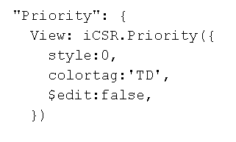
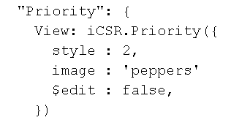
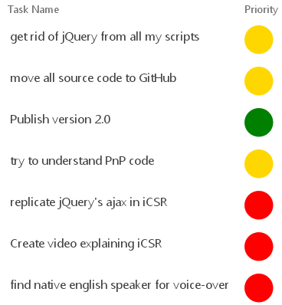
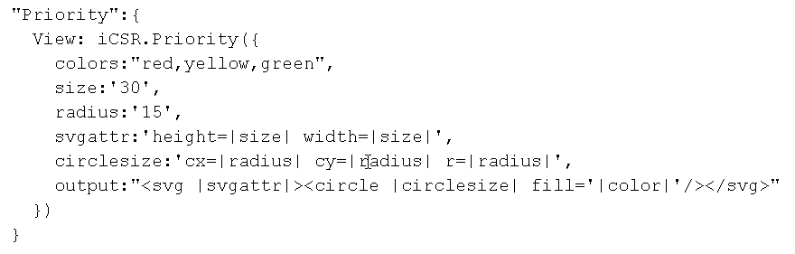
iCSR.Priority Template with user configuration examples
color the TD cell
use SharePoints _layouts/images
Yes, ‘TR’ will do what you think it does
Kpi- Image names: peppers, default, pepperalarm, normal
or add your own |tokens| and HTML (SVG)

Slide 17
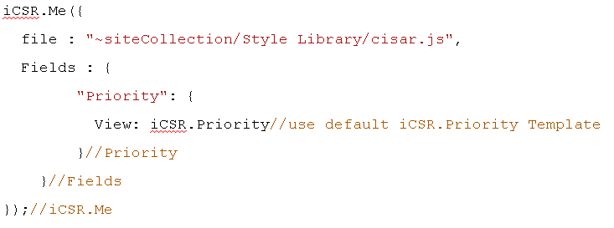
iCSR Templates are interactive in Views, who needs Forms?
Loading GIF animation
By default an iCSR Template is interactive (for those with edit rights)
No additional configuration is required, but can still be applied

Slide 18
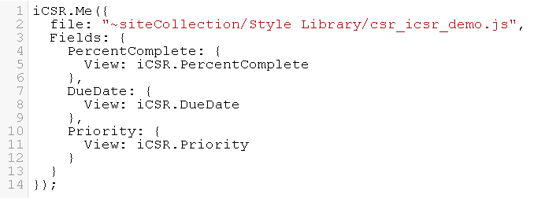
So iCSR can enhance any List or Library
With the icsr.js Framework and one 14 line CSR file
Ofcourse you can concatenate the files into one file if you want

Slide 19
F12 Dev console goodies
Template tokens
‘icPriority’
‘icPercentComplete’
‘icDueDate’
‘iccolors’ Colornames
iCSR.GitHub.io

Slide 20
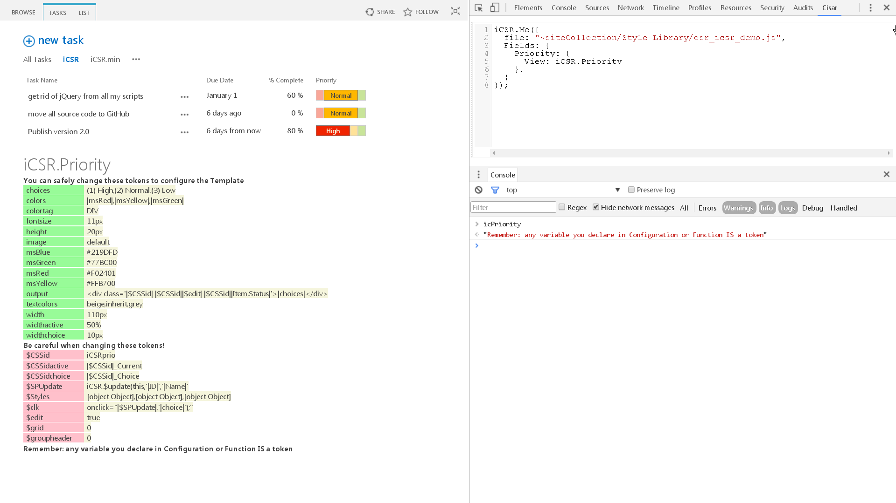
F12 Console functions help explore Template configurations
Template: iCSR.Priority

Slide 21
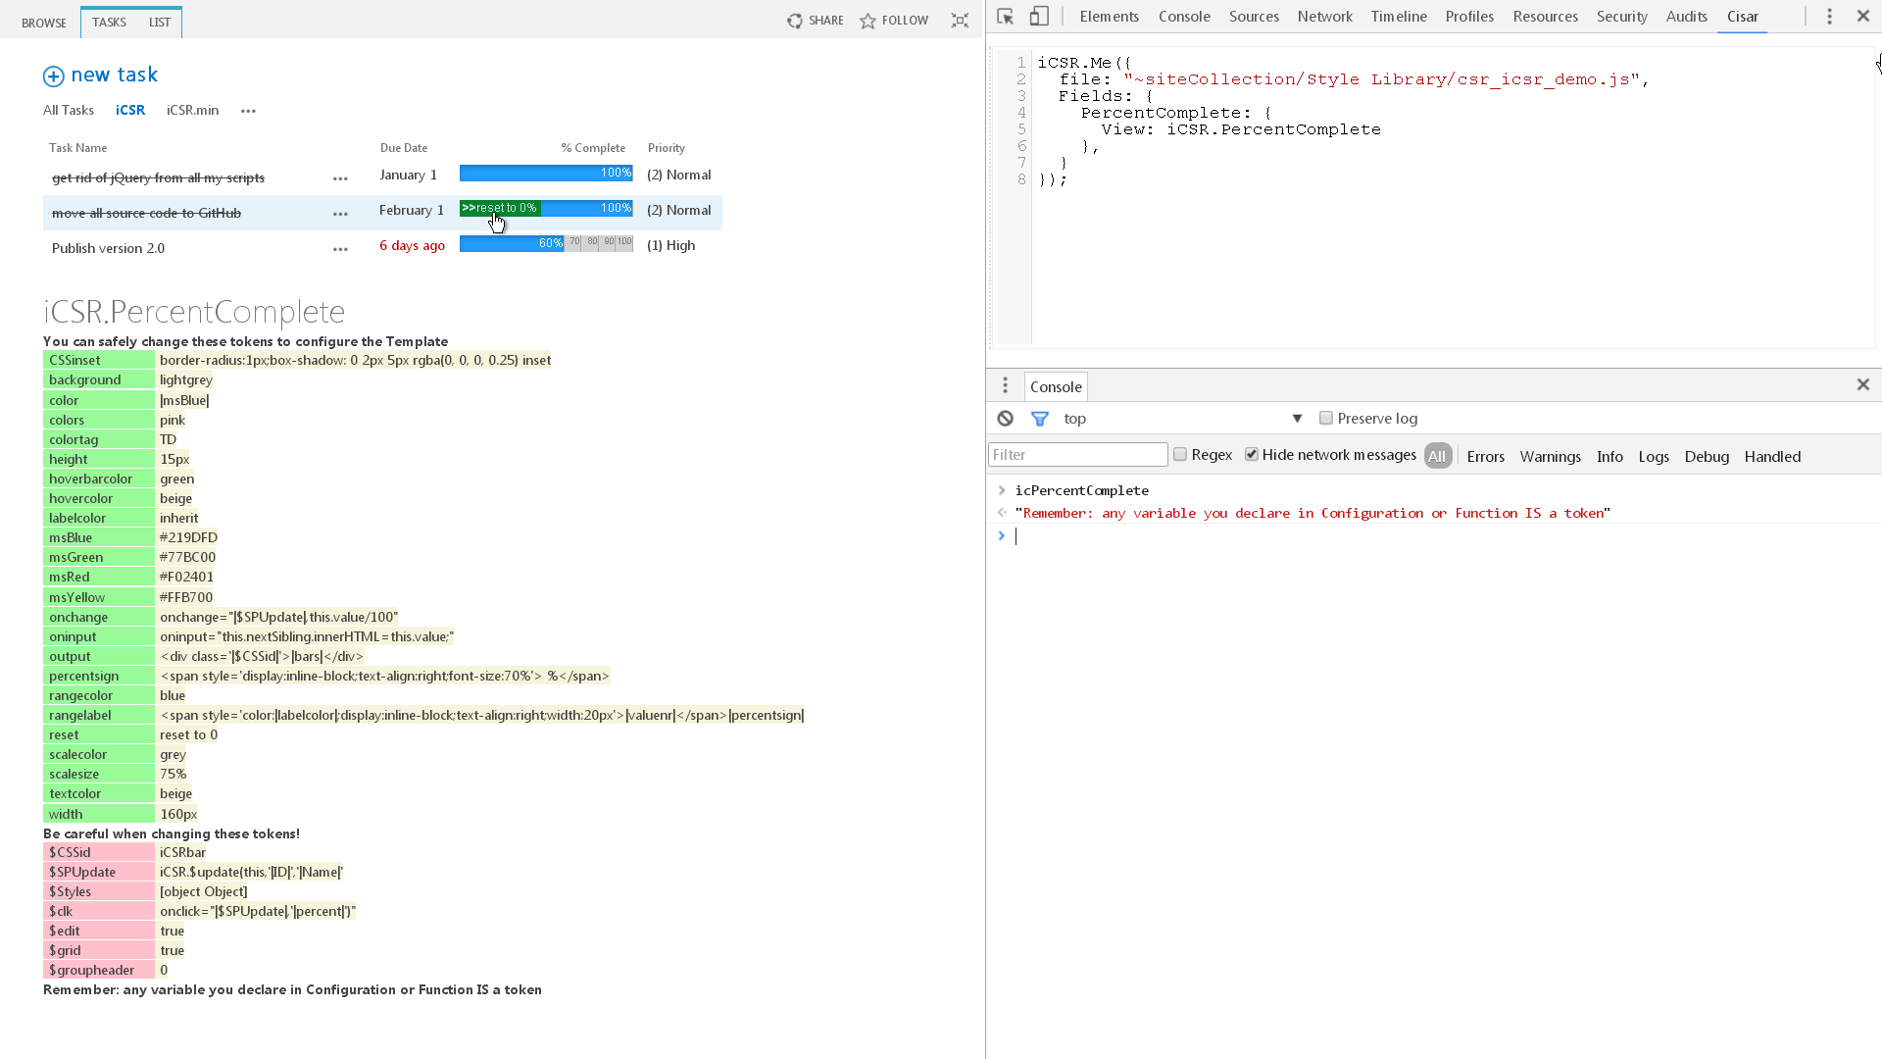
Template: iCSR.PercentComplete

Slide 22
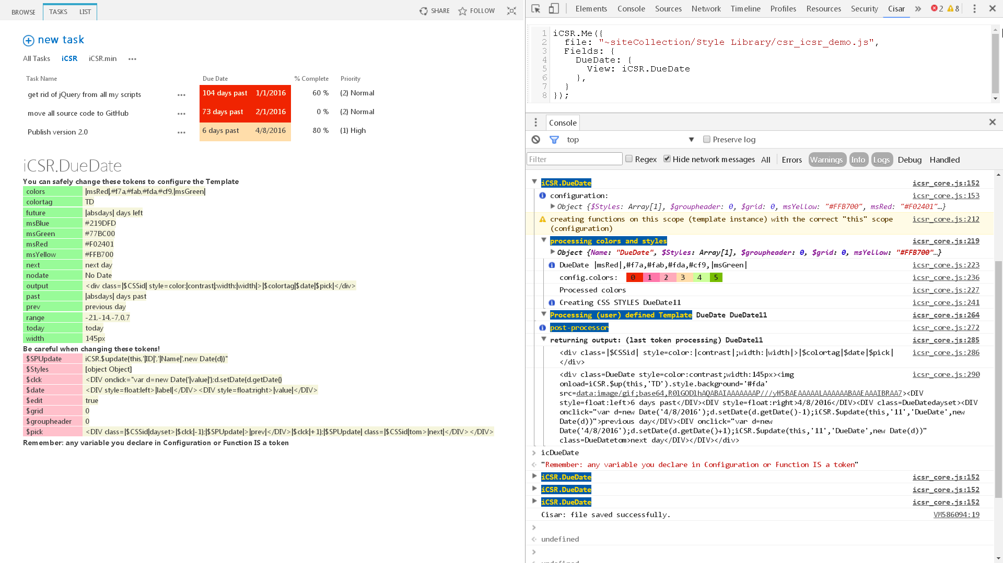
Template: iCSR.DueDate
The iCSR.js development version has extensive logging

Slide 23
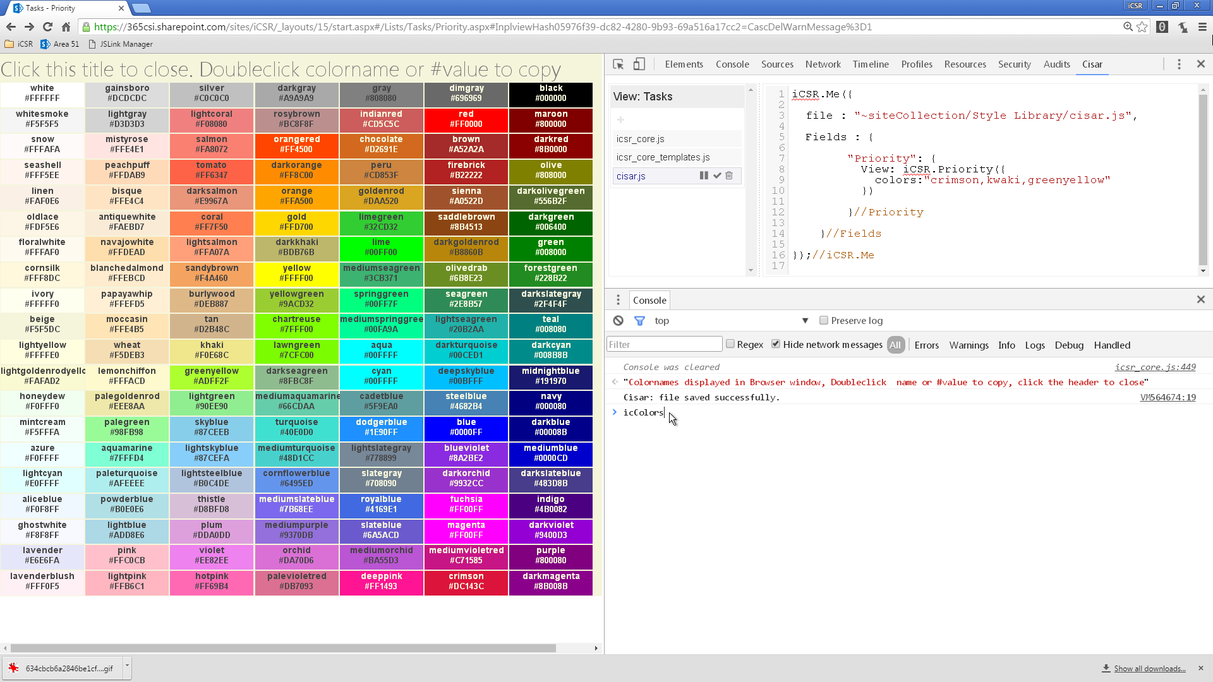
Don’t know all the HTML color names?
Type ‘icColors’ in the developer console

Slide 24
creating
new
Templates
iCSR.GitHub.io

Slide 25
How iCSR Templates work
iCSR Priority FUNCTION (declaration)
CSR engine
Hey CSR call me for displaying Priority fields
“Priority”:{ View: iCSR.Priority }
Template Configuration
User Configuration
CSR engine
Give me the HTML for one Priority Item
iCSR Priority FUNCTION (execution)
CSR engine
HTML
The Template Function has TWO operations
When called without the ctx object parameter, it returns the function declaration to CSR
When called (by CSR) with the ctx object, it executes the Template function returning HTML
iCSR.Priority( { colors: “red,yellow,blue” } );
User Configurations overwrite default Template configuration

Slide 26
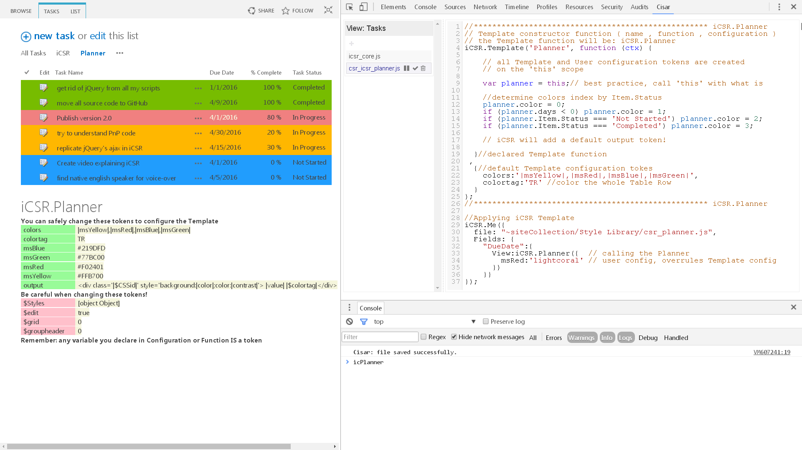
Creating a NEW Template: iCSR.Planner
(Color rows with Office365 Planner colors)
takes only a few lines of JavaScript

Slide 27
iCSR.js is available at iCSR.GitHub.io
icsr_core.js development: 30 KB minified production: 3.2 KB I can get it down to 2691 Bytes, but readability suffers
icsr_core_templates.js Priority, PercentComplete, DueDate, Status development: 17 KB minified production: 6.4 KB
 | jQuery | jQuery UI | Angular | Knockout | ngOfficeFabric | iCSR
Dependencies |  | jQuery |  |  | Angular
Minified production | 81 KB | 292 KB | 144 KB | 58 KB | 102 KB | 3 KB
development: 47 KB minified production: 9.6 KB

